Slide 1



INDUSTRY PERSPECTIVE BIG DATA
HK Curries RESTAURANT
By:
Ketan
Rahul
Praveen

Slide 2


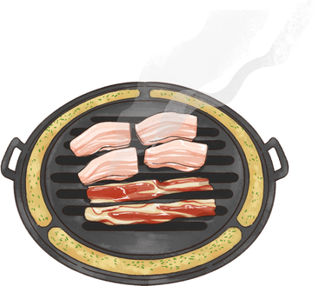

AGENDA
SCHEMA DESIGN
ARCHITECTURE
GOVERANCE AND DATA SECURITY
CLOUD VS TRADITIONAL
TOOLS / APPLICATIONS

Slide 3

STAR SCHEMA
Inventory
Ingredient ID
Item ID
Employee ID
Customer ID
Inventory ID
Order ID
ORDERS
Order ID
Employee ID
Customer ID
Item ID
Inventory ID
MenuITems
Item ID
Name
Price
Employees
Employee ID
Name
Position
Customers
Customer ID
Name
Payment
Ingredients
Ingredient ID
Quantity
Facts Tables
Dimension Table
Dimension Table
Notes:
We are a starup f&B restaurant.
CHOOSE STAR SCHEMA-
efficient at storing data, maintaining history, and updating data by reducing the duplication of repetitive business definitions.
1) simple to understand and implement
enable users to slice and dice the data however they see fit,
2) Great for simple queries because of their reduced dependency on joins when accessing the data
3) Computationally quick

Slide 4



ARCHITECTURE
DATA SOURCES
ETL & DATA WAREHOUSING
ANALYTICS
REPORTING
Amazon RDS
(online orders)
Warehouse: Amazon Redshift for analytics-ready data storage.
Amazon Kinesis
(Real time)
Tableau
ETL: AWS Glue for data transformation
POS Systems
(restaurant sales and inventory data)
SECURITY & COMPLIANCE
Amazon Kinesis
(customer interactions)
AWS KMS and CloudTrail for security

Slide 5

GOVERNANCE AND SECURITY
Amazon Redshift ensures uniform data analytics by serving as a single source of truth.
CENTRALIZED MANAGEMENT
COMPLIANCE MONITORING
AWS Glue maintain data quality and
GDPR compliance.
Administrators
Analysts
Managers
ACCESS CONTROL
AWS KMS encrypts data
AWS CloudTrail monitors access, enhancing security and compliance.
DATA PROTECTION

Slide 6
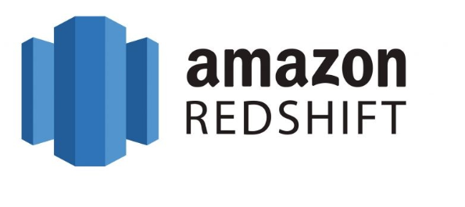

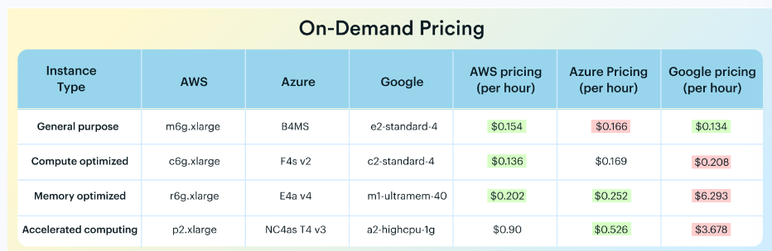

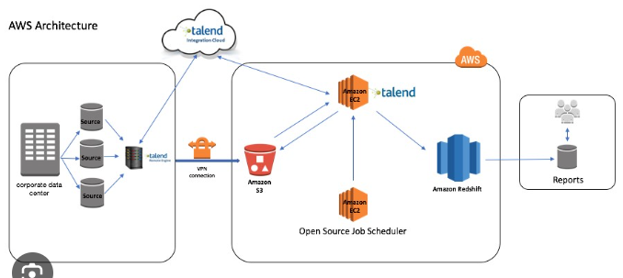
CLOUD BASED APPROACH
SCALABILITY
To grow seamlessly
handling increasing amounts of data without compromising performance.
COST EFFICIENCY
To pay only for the resources used.
To reduce unnecessary costs and optimizing budget allocation
INTEGRATION CAPABILITIES
AWS technologies, such as Lambda for serverless computing,
S3 for data storage, and IAM for security, offer a comprehensive and cohesive solution .

Slide 7





TOOLS AND APPLICATIONS
AWS Glue simplifies the Extract, Transform, Load (ETL) process, automating data preparation and enabling seamless integration with various data sources.
Amazon Redshift provides a powerful, fully managed data warehousing solution, offering scalability and high-performance analytics for restaurant data.
AMAZON REDSHIFT FOR DATA
WAREHOUSING
AWS GLUE FOR ETL
Kinesis Data Streams allows real-time processing of restaurant data, enabling instant insights into online orders, reservations, and customer behavior.
Tableau and QuickSight offer robust business intelligence capabilities, allowing the creation of interactive dashboards and reports to visualize restaurant performance.
KINESIS DATA STREAMS FOR REAL-TIME ANALYTICS
BUSINESS INTELLIGENCE TOOLS
TABLEAU, QUICKSIGHT

Slide 8



THANK YOU!
KETAN BOPANNA
RAHUL RAAVI
PRAVEEN SUBRAMANI

